Slide 1
ARTIFICIAL ANT COLONY OPTIMIZATION
Ayşe Betül CENGİZ

Slide 2
Content
Ants as biologically
Ants as swarm
Ants as artificially
Ant colony optimization
Main concepts
Pros and cons
Usage areas
Literature

Slide 3

Ant
Ants are eusocial insects of the family Formicidae and, along with the related wasps and bees, belong to the order Hymenoptera (Wikipedia, Ant).
Almost blind
Pheromone
Notes:
Eusocial: the highest level of organization of sociality.
(Fizyolojik olarak karıncaların görüşü kötü ile orta düzey arasındadır, hatta yeraltında yaşayan bazı türler tamamen kördür.)

Slide 4
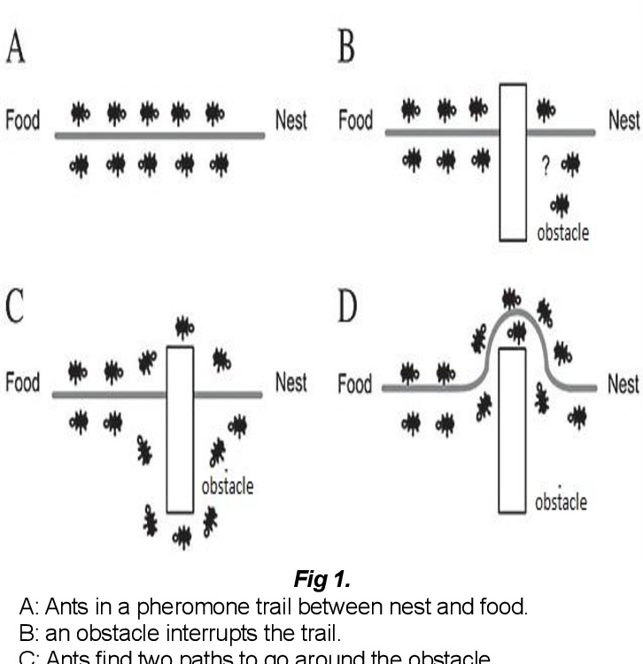
Behaviours of a Real Ant Colony [1, 2]
Random travellers
Secreting pheromone
Feedbacking to the colony

Slide 5
Behaviours of a Real Ant Colony (Cont.) [1, 2]
Main route is created
The amount of pheromone
increases

Slide 6
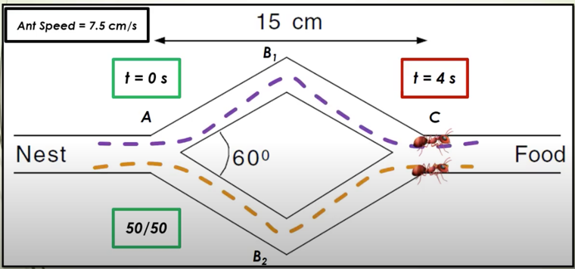
Behaviours of a Real Ant Colony (Cont.)
Experiment with equal length paths
Notes:
otokatalitik mekanizma

Slide 7
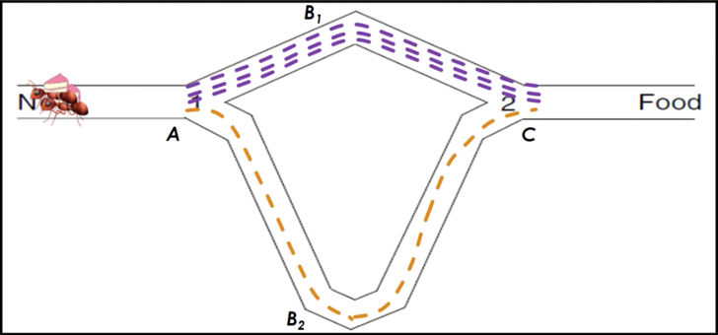
Behaviours of a Real Ant Colony (Cont.)
Experiment with different length paths

Slide 8
Behaviours of a Real Ant Colony (Cont.) [1, 2]
Encounter an obstacle
Travel around obstacle
The shortest path has
more pheromone

Slide 9
Dorigo et al. [3]
A new general-purpose heuristic algorithm which can be used to solve different combinatorial optimization problems (1996).
It is versatile.
It is robust.
It is a population based approach.
Notes:
gezgin satıcı problemi (GSP) ve kuadratik atama (QAP) gibi zor optimizasyon problemlerinin çözümü için geliştirilmiştir.

Slide 10
Artificial Ant
Artificial ants have a certain memory
Not exactly blind
Multiple individuals
Notes:
Her ne kadar karınca kolonilerinden esinlenilse de geliştirilen yöntem temelinde bölgesel etkileşen çok sayıda bireyin idare edilmesidir.

Slide 11
Ant Colony Optimiziation (ACO)
The ACO algorithm consists of a number of iterations. In each iteration, a number of ants construct complete solutions by using heuristic information and the collected experiences of previous populations of ants. These collected experiences are represented by using the pheromone trail, which is deposited on the constituent elements of a solution [4].

Slide 12
Algorithm
For each ant:
Secrete amount of pheromone from i to j.
Choose a food source to go based on a probability function that depends on the amount of pheromone and distance.
Force the ants to go to untouched resources after a depleted resource. (Tabu list)
Notes:
Roulette Wheel Selection , Fitness Proportionate Selection

Slide 13
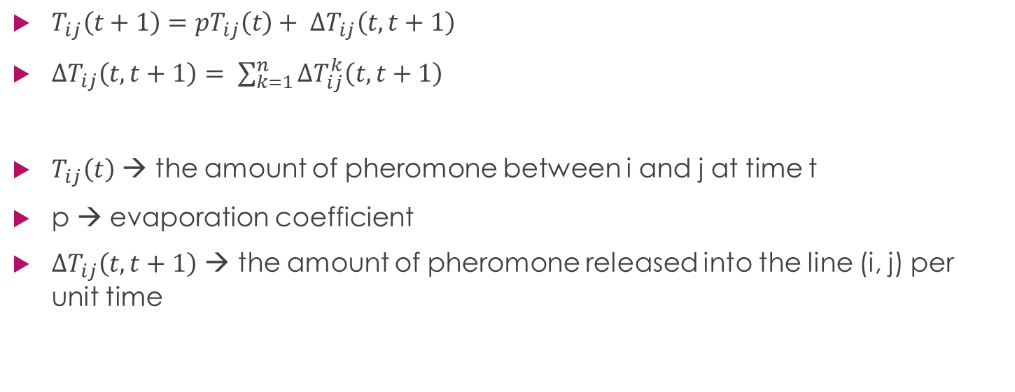
Pheromone updating
$T_{ij}\left(t+1\right)={pT}_{ij}\left(t\right)+ ∆T_{ij}\left(t, t+1\right)$
$∆T_{ij}\left(t, t+1\right)= \sum_{k=1}^{n}{∆T_{ij}^{k}\left(t, t+1\right)}$
$T_{ij}\left(t\right)$ → the amount of pheromone between i and j at time t
p → evaporation coefficient
$∆T_{ij}\left(t, t+1\right)$ → the amount of pheromone released into the line (i, j) per unit time

Slide 14
Evaporation
To avoid to go depleted resources
To avoid going to farther sources
The evaporation coefficient is chosen arbitrarily

Slide 15
Advantages
A large population can be searched simultaneously.
Can quickly discover good solutions.
It can adapt quickly to new targets, it is dynamic.
It guarantees convergence to the target.
Offers effective solutions to the Traveling Salesman Problem and similar problems.

Slide 16
Disadvantages
The probability distribution can vary for each iteration.
Theoretically, it is difficult to analyze.
It is more experimental rather than theoretical research.
It is uncertain when the target will converge, too much iteration may be required.
It consists of random decision sequences.
Overlooked paths

Slide 17
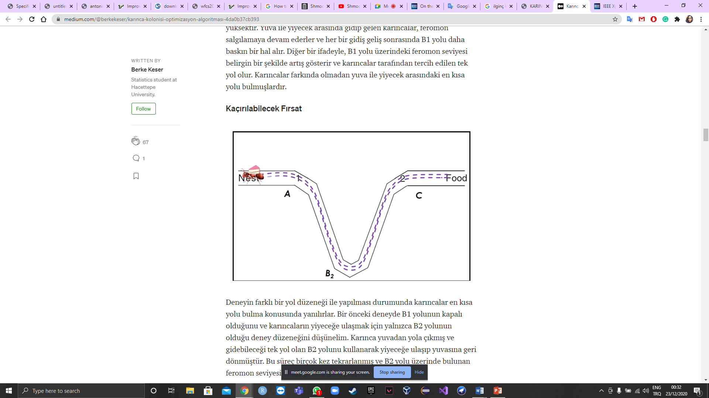
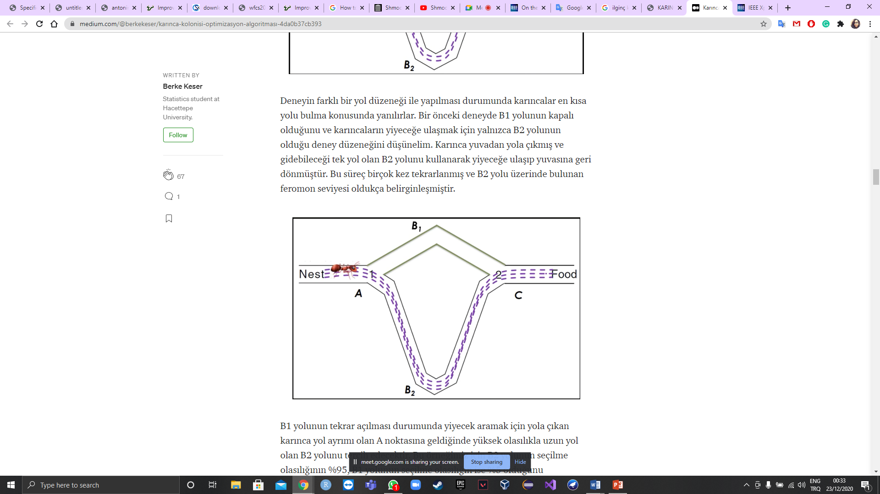
Disadvantages

Slide 18
Usage areas
Scheduling problem
Routing problem
Image processing
Edge detection
Notes:
, komünikasyon ağlarının belirlenmesi, grafik renklendirme, iş çizelgeleme, Veri tabanlarında yapılan sorguların optimizasyonunda

Slide 19
Literature - Network
A multi-objective optimization method of initial virtual machine fault-tolerant placement for star topological data centers of cloud systems: Zhang W., Chen X., Jiang J. (2021).
A model of initial VM fault-tolerant placement for star topological data centers of cloud systems
Ant colony algorithm is proposed to solve the model
Notes:
Yıldız topolojisine göre tasarlanmış data centerların yerleştirilmesiyle ilgili
Fiziksel makine çöktüğünde sanal makinenin çökmemesini sağlayan bir teknoloji.

Slide 20
Literature - Network (Cont.)
Africa 3: A Continental Network Model to Enable the African Fourth Industrial Revolution: Ajayi O. O., Bagula A. B., Maluleke H. C. (2020).
A continental network model for interconnecting nations in Africa through its data centres
A multilayer network engineering approach
Ant Colony Optimisation with Stench Pheromone
Notes:
Afirka devletlerinin haberleşmesi için bir network kurmak isteniyor. Bunun için data centerların yerleştirilmesi ve yönetilmesiyle ilgili – pis kokulu feremon

Slide 21
Literature - Network (Cont.)
Efficient Task Offloading for IoT-Based Applications in Fog Computing Using Ant Colony Optimization: Hussein M., Mousa M. (2020).
Proposes two different scheduling algorithms to effectively load balance IoT tasks over the fog nodes under communication cost and response time considerations.
Notes:
IOT fog ve bulut haberleşmesinde
Particle swarm optimization – round robin

Slide 22
Literature – Vehicle routing
Route Optimization for Last-Mile Distribution of Rural E-Commerce Logistics Based on Ant Colony Optimization: Liu W. (2020).
Problem: the last-mile distribution of rural e-commerce logistics (RECL) for the survival of third-party logistics enterprise
A new improved model
Notes:
E ticaret sitelerinde yapılan alışveriş ürünlerinin teslimatı - gezgin satıcı problem

Slide 23
Literature – Path Planning
Path Planning for Intelligent Parking System Based on Improved Ant Colony Optimization: Wang X., Shi H., Zang C. (2020).
Based on automated guided vehicle (AGV), the intelligent parking system provides a novel solution to the difficulty of parking in large cities.

Slide 24
Literature – Human routing
Study on Safe Evacuation Routes Based on Crowd Density Map of Shopping Mall: Sun S. L., Zhao Q., Xie W. Z. (2020).
Large shopping malls → crowd density maps
Crowd density map is generated by the improved multiscale CNN.
Evaporition coefficient is measured through adaptive adjustment by using the exponential decline method
Notes:
Avmlerdeki kalabalığın tahliye noktalarına güvenli bir şekilde ulaştırılması için rota oluşturulması

Slide 25
Literature – Robot routing
Dynamic Multi-Role Adaptive Collaborative Ant Colony Optimization for Robot Path Planning: Zhang D., You X., Liu S., Pan H. (2020).
Robot path planning
Dynamic multi-role adaptive collaborative ant colony optimization (MRCACO)

Slide 26
Literature - Scheduling
An Improved Ant Colony Optimization Algorithm Based on Hybrid Strategies for Scheduling Problem: Deng W., Xu J., Zhao H (2019).
ICMPACO: Improved ant colony optimization
Based on the multi-population strategy, co-evolution mechanism, pheromone updating strategy, and pheromone diffusion mechanism
The traveling salesmen problem (TSP) and the actual gate assignment problem

Slide 27
Literature - Scheduling
Shared Bikes Scheduling Under Users’ Travel Uncertainty: Zhang Z., Zhang X. (2020).
To solve unbalanced scheduling problem of shared bikes.
Notes:
Mobike - kullanım yönetimi
Ne kadar süre kullanılacak
Ne kadar mesafe

Slide 28
Literature - Healthcare
Deep Semantic Segmentation and Multi-Class Skin Lesion Classification Based on Convolutional Neural Network: Anjum M. A., et al. (2020).
The method is proposed for localization, segmentation and classification of the skin lesion at an early stage
3-phase-based approach
ANNs + 13-layer 3D-semantic segmentation model + ResNet-18
To optimized features, ACO was used
Notes:
Ben tespiti. 3 fazdan oluşuyor. Karınca algoritmasını yapay sinir ağlarının featurelarını optimize etmek için kullanmışlar

Slide 29
Literature - Healthcare
Surveillance Routing of COVID-19 Infection Spread Using an Intelligent Infectious Diseases Algorithm: Guevara C., Penas M. S. (2020).
The Intelligent Infectious Diseases Algorithm (IIDA)
To locate the sources of infection and survival rate of coronavirus disease 2019
To propose health care routes for population affected by COVID-19

Slide 30
References
Karaboğa D., Yapay zeka optimizasyon algoritmaları, Atlas Yayınları, 2004.
https://www.semanticscholar.org/paper/Ant-Colony-Optimization-(ACO)-For-The-Traveling-Bajpai-Yadav/87c2853a0739f63841aae5cca5e385244c541e73/figure/0
M. Dorigo, V. Maniezzo and A. Colorni, "Ant system: optimization by a colony of cooperating agents," in IEEE Transactions on Systems, Man, and Cybernetics, Part B (Cybernetics), vol. 26, no. 1, pp. 29-41, Feb. 1996, doi: 10.1109/3477.484436.
W. Deng, J. Xu and H. Zhao, "An Improved Ant Colony Optimization Algorithm Based on Hybrid Strategies for Scheduling Problem," in IEEE Access, vol. 7, pp. 20281-20292, 2019, doi: 10.1109/ACCESS.2019.2897580.

Slide 31
THANK YOU

